Slide 1
Final Project
최신기술프로젝트

Slide 2
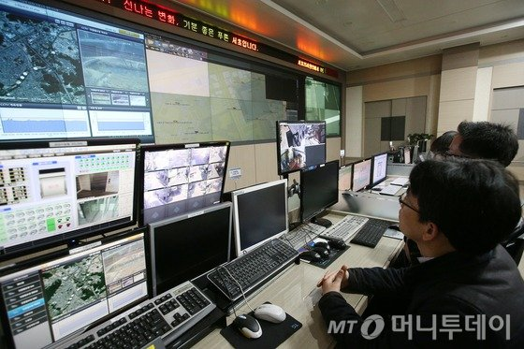
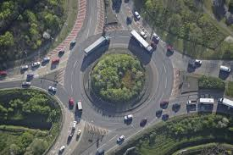
Information from Image
Motivation
Get Information!
Watching directly

Slide 3
Information from Image
Motivation
Get Information!
Watching directly
The method does not support a lot of data.

Slide 4

Information from Image
Motivation
Get Information!
Create a log file

Slide 5
Information from Image
Motivation
Get Information!
Create a log file
However, the method has a problem that missing necessary data or redundant data occurs.

Slide 6
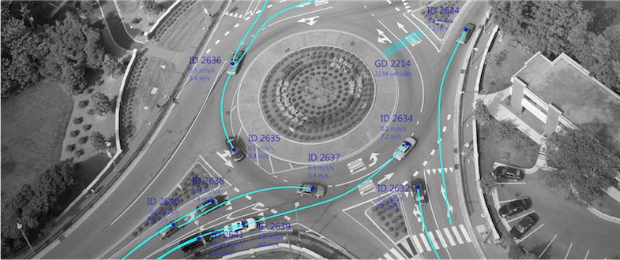
Want Information From Image !
Motivation
Get Information!
Extract information from image

Slide 7
Want Information From Image !
Motivation
Get Information!
Extract information from image
This method can extract only the information we need.

Slide 8


How to Get Information in Image ?
Motivation

Slide 9
How to Get Information in Image ?
Motivation
It is hard to adopt distribution algorithm, because image composed of a matrix
Ex) mapreduce(Key,Value) ,graph(node,edge)

Slide 10
How to Get Information in Image ?
Motivation
Spark MLlib has image processing algorithm.
But spark performs navie image processing
Ex) random forest, Kmeans

Slide 11

Using Deep Learning
Acquisition
Image Segmentation!

Slide 12
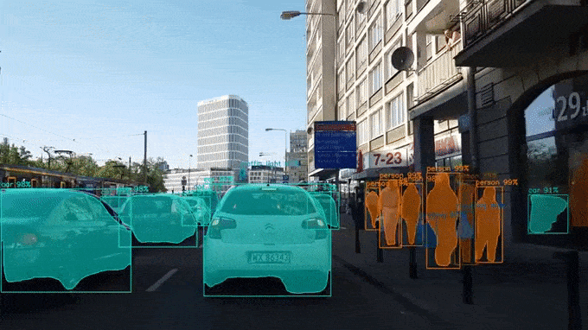
Mask -RCNN
Acquisition
Mask R-CNN is algorithm that performs image segmentation & detection
It is composed of Faster RCNN & R-FCN

Slide 13
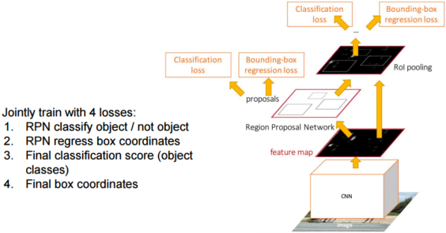
Faster R-CNN
Acquisition

Slide 14
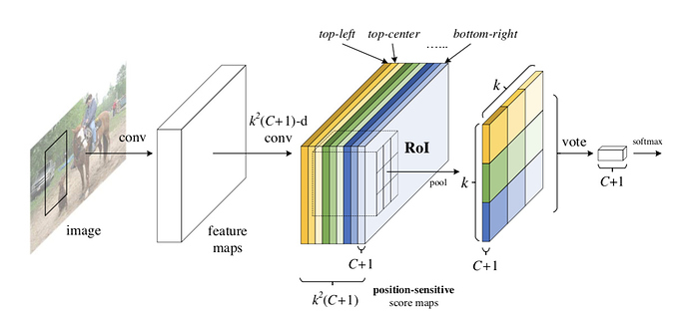
R-FCN
Acquisition

Slide 15
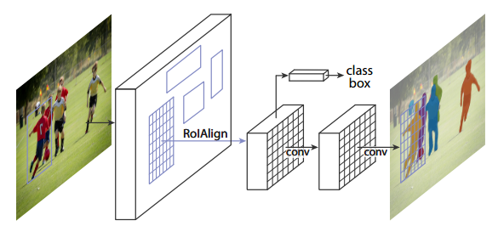
Mask R-CNN
Acquisition

Slide 16
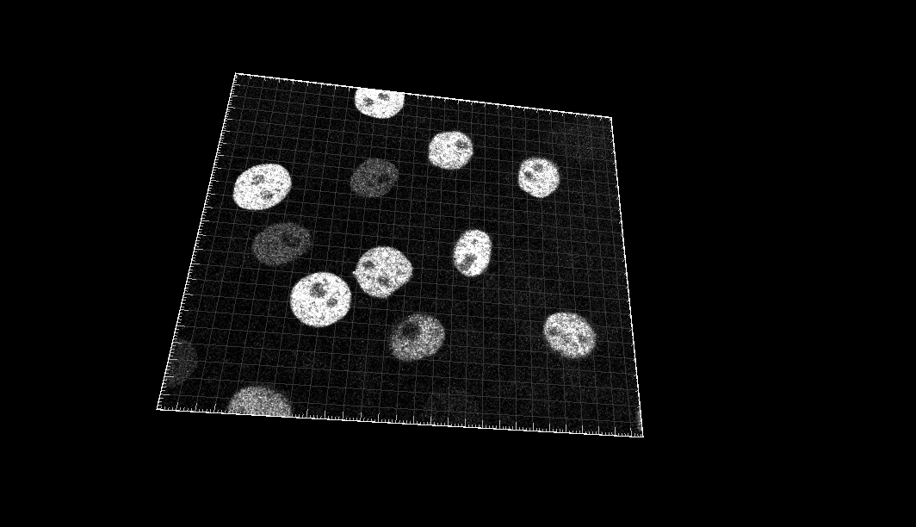
About Datasets
Acquisition
In Cell tracking Challenge
kinds : 15 Class(2D or 3D)
type: tiff files
size: ~ 46.3Gb

Slide 17
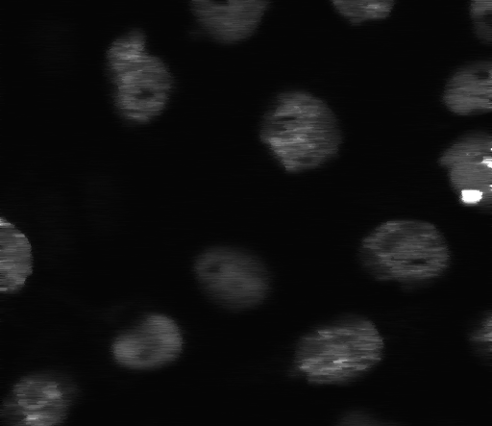
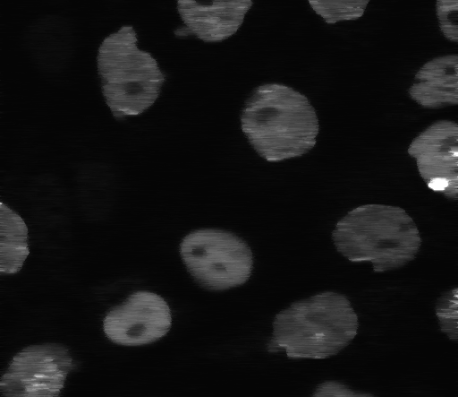
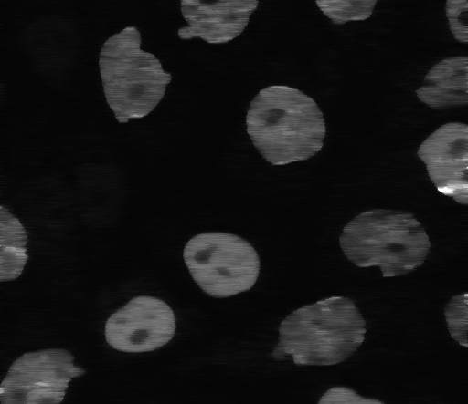
Data Preprocessing in local
Processing
Frame Split
Total 102,989 images

Slide 18
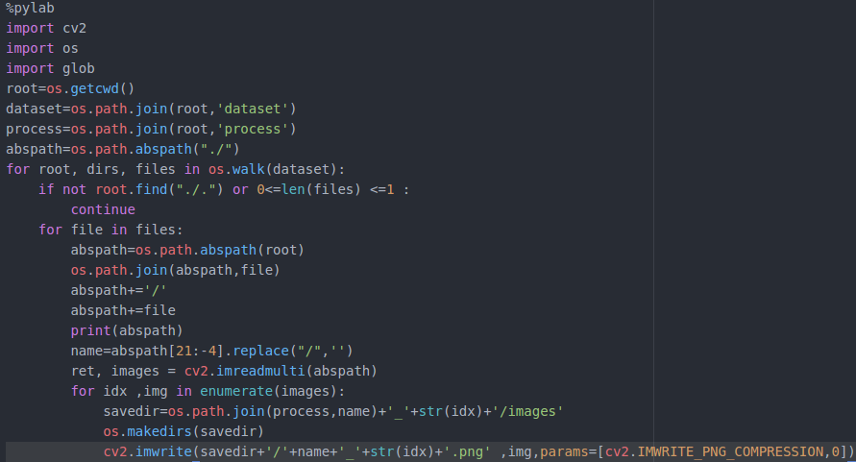
Data Preprocessing in local
Processing
Read All Frame &
Saving All
Frame Split
Total 102,989 images

Slide 19

Data Preprocessing in local
Processing
Split 103 Batch
If you process 100,000 at a time, the processor is killed..

Slide 20
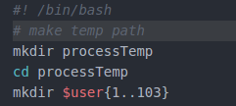
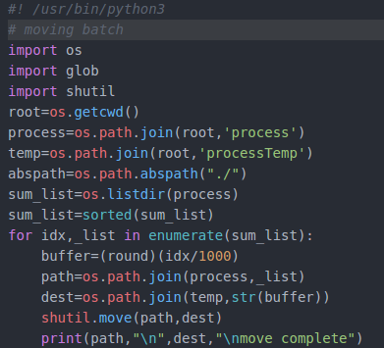
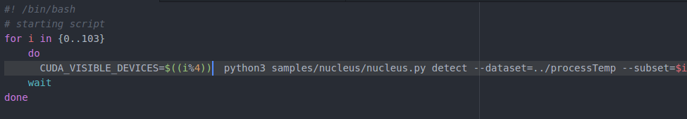
Data Preprocessing in local
Processing
Split 103 Batch
If you process 100,000 at a time, the processor is killed..

Slide 21
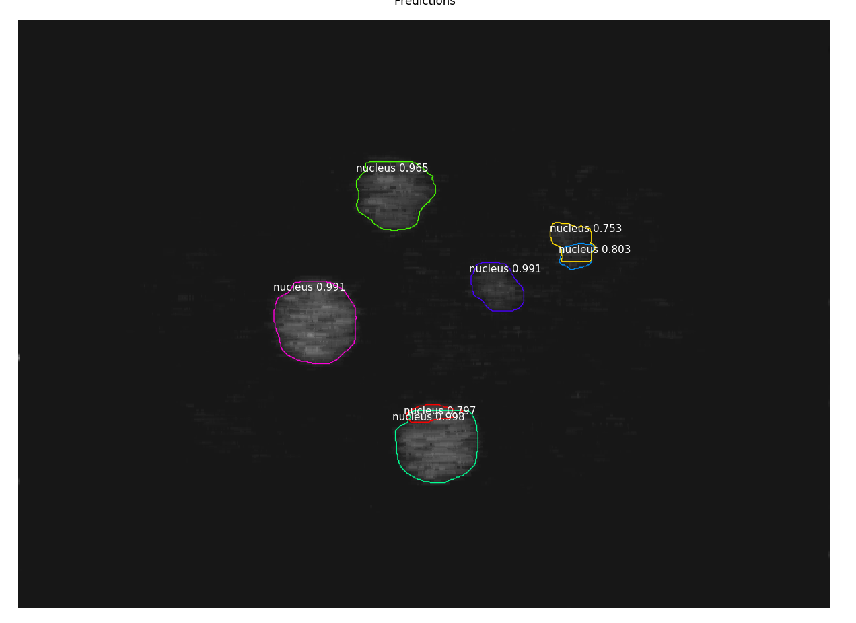
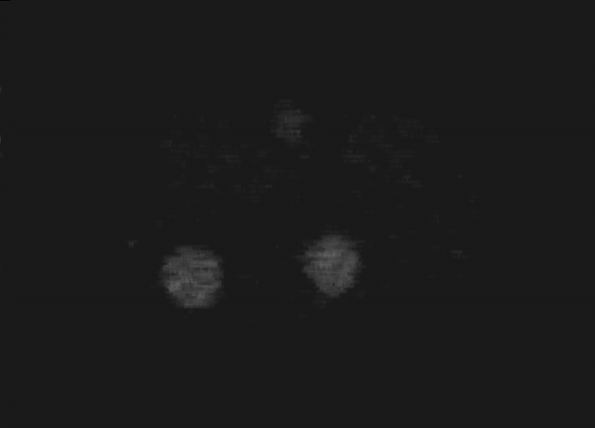
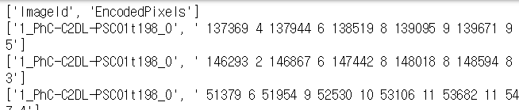
Data Acquisition from Image
Processing
Result Image
Mask R-CNN
Metadata

Slide 22
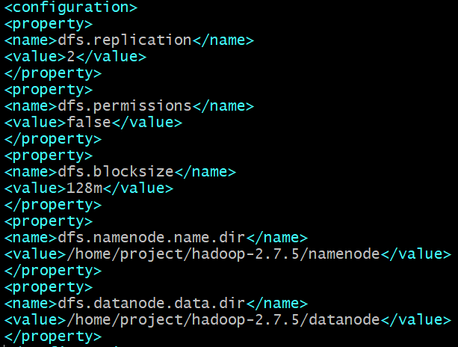
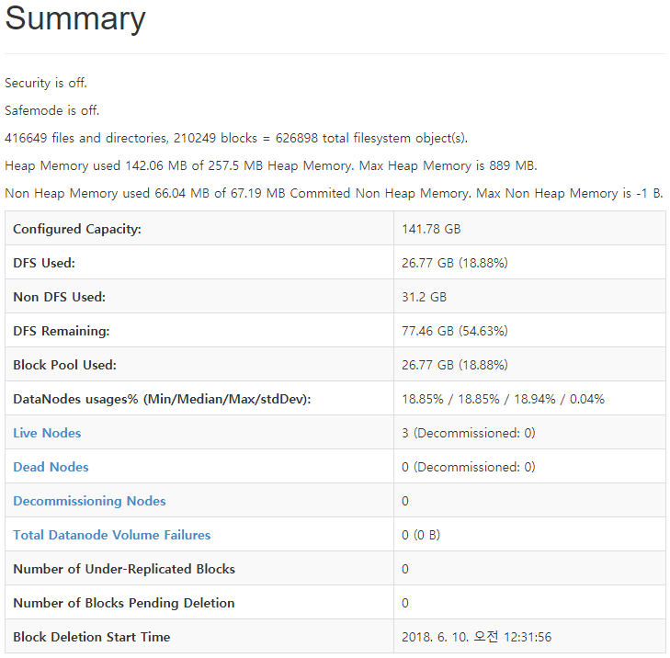
HDFS Config
Data Storage

Slide 23
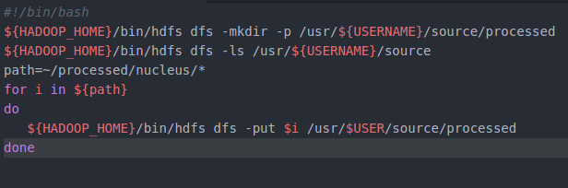
HDFS Loading

Slide 24
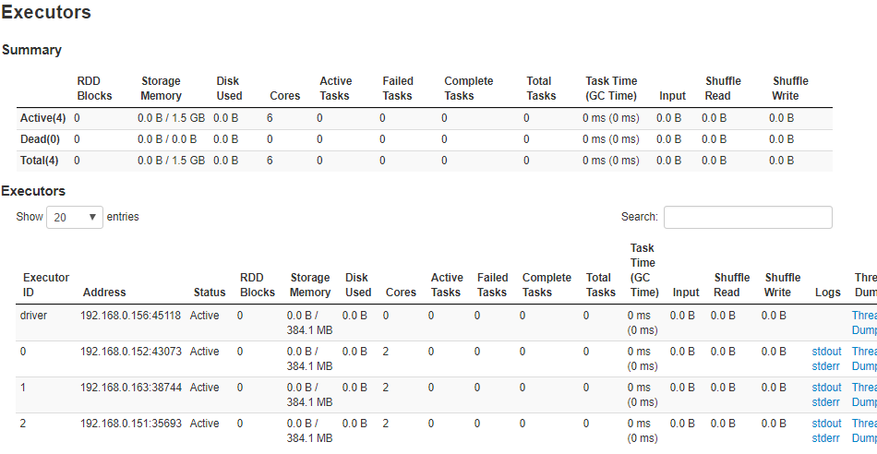
Spark Config
Processing
1 master ,3 worker
standalone
cluster mode
<spark web ui>

Slide 25
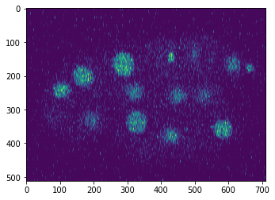
Spark Processing - Image preprocessing
Processing
Image has a noise!

Slide 26
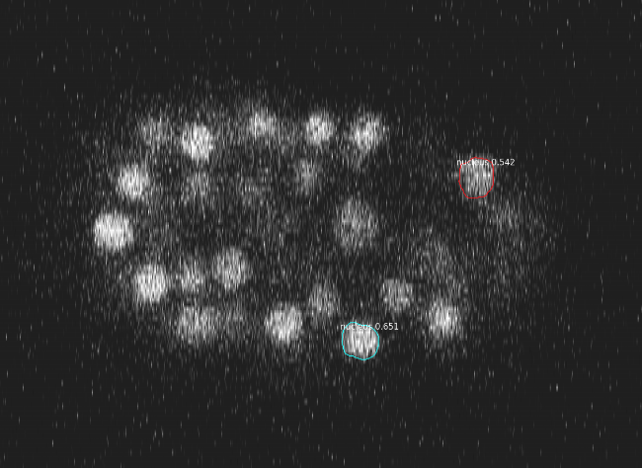
Spark Processing - Image preprocessing
Processing
Image has a noise!
So algorithm does not work well!

Slide 27
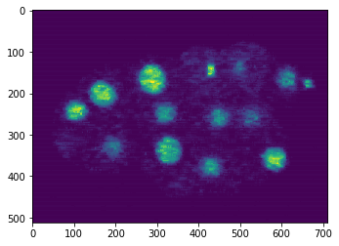
Spark Processing - Image preprocessing
Processing
Apply median filter in spark

Slide 28
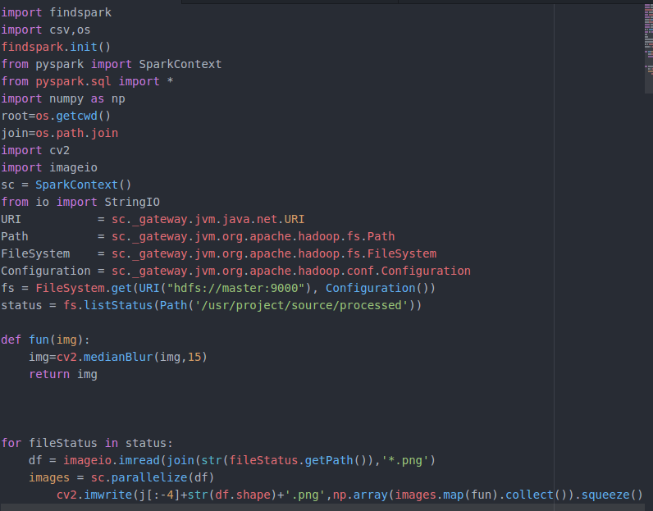
Spark Processing - Image preprocessing
Processing
Read hdfs path in python
Define medianBlur
Apply median filter in spark
Apply & saving

Slide 29
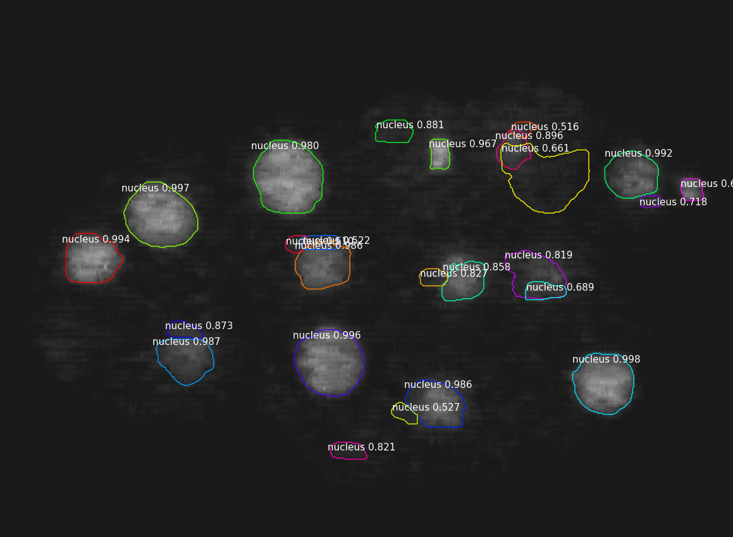
Spark Processing - Image preprocessing
Processing

Slide 30
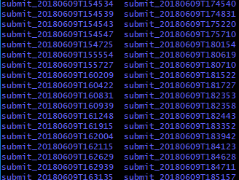
Spark Processing - csv processing
Processing
103 folders
png files & one csv in a folder

Slide 31
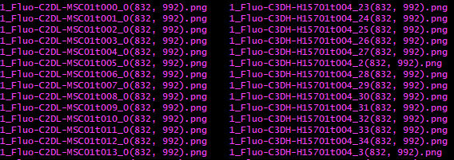
Spark Processing - csv processing
Processing
For decode,
need to know pixel size (shape)

Slide 32
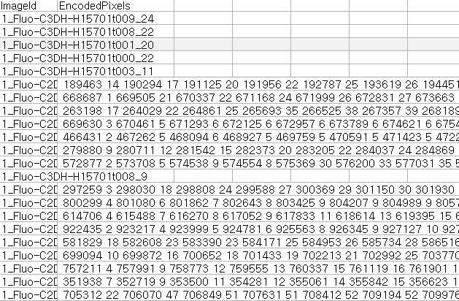
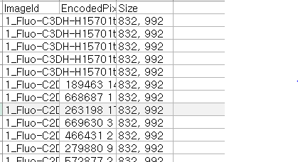
Spark Processing - csv processing
Processing
Before size process
After size process

Slide 33
Spark Processing - csv processing (Decoding)
Processing
ex) 189463 14 190294 17 ...
RLE Encoded Pixels
Mask Array
...
... 00000000 ...
... 00011110 ...
... 00011100 ...
… 00001000 ...
... 00000000 ...
...
Decoding
Function
ex) 832 x 992 = 825,344
Shape Value

Slide 34
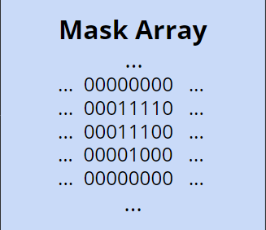
Spark Processing - csv processing (Decoding)
Processing
Count number of 1
cell ratio - 1’s count / shape

Slide 35
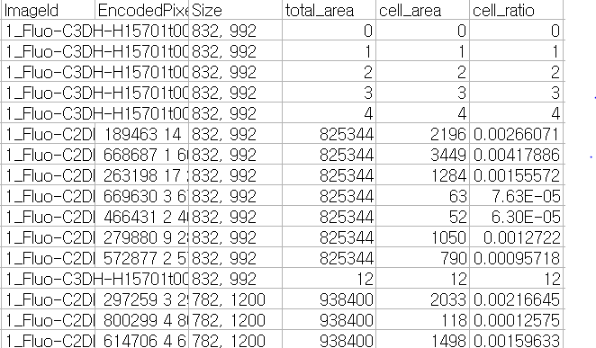
Spark Processing - csv processing
Processing
Before decoding
After decoding

Slide 36


Data Visualization
Visualize

Slide 37
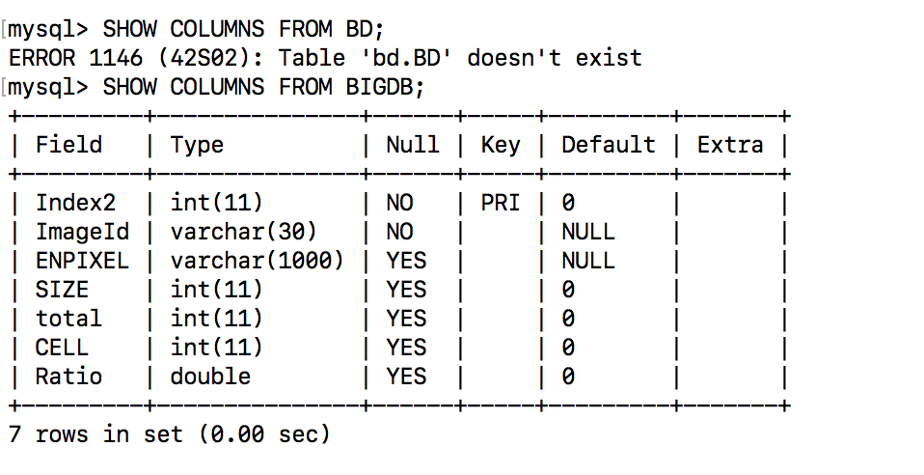
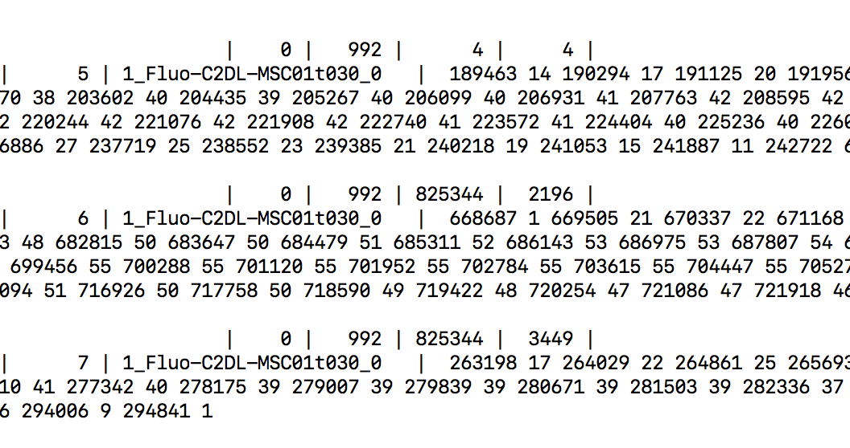
Visualize
Data to Mysql

Slide 38
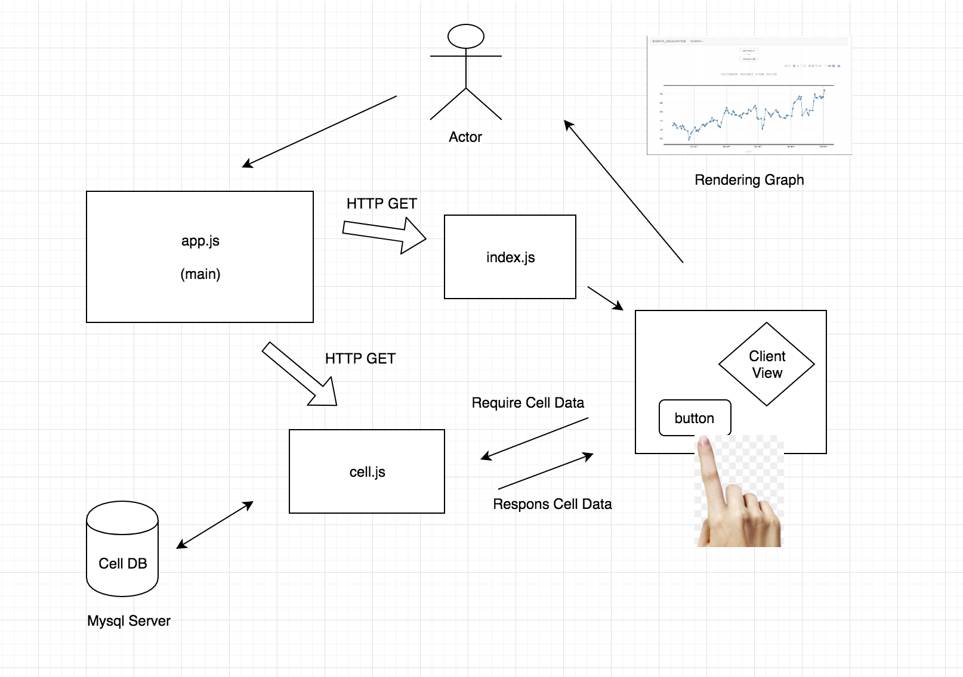
Results
Overall Server & Client Structure
‘C’ontroller
‘V’iew
‘M’odel

Slide 39
Review

Slide 40
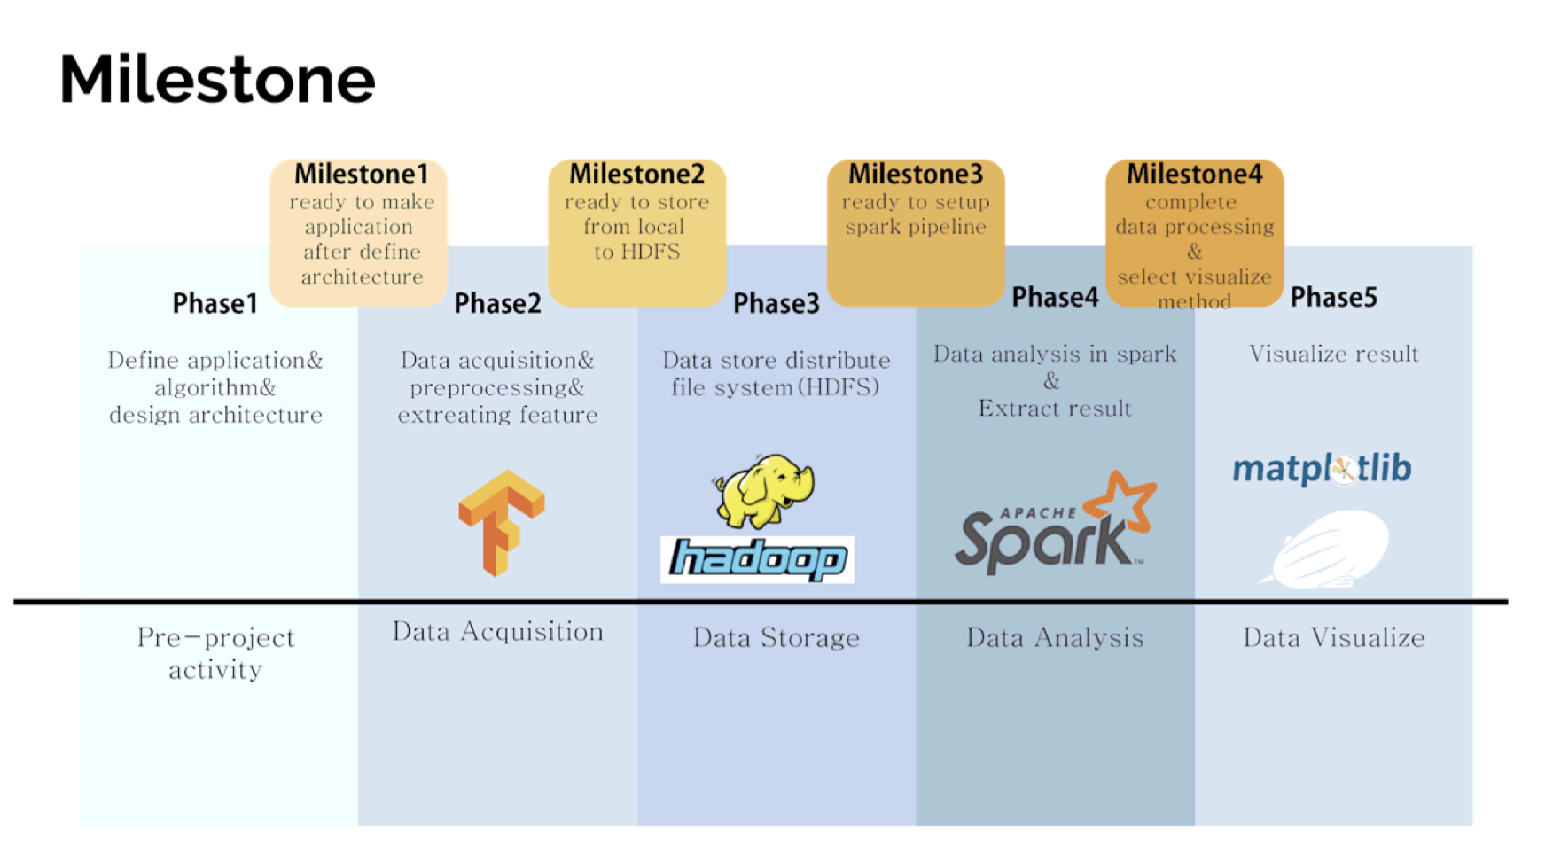
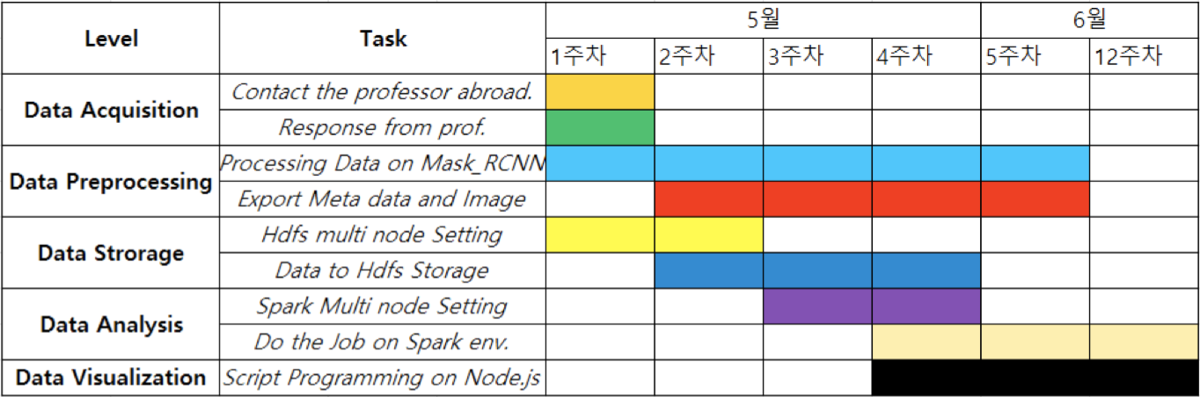
How to follow the milestone

Slide 41
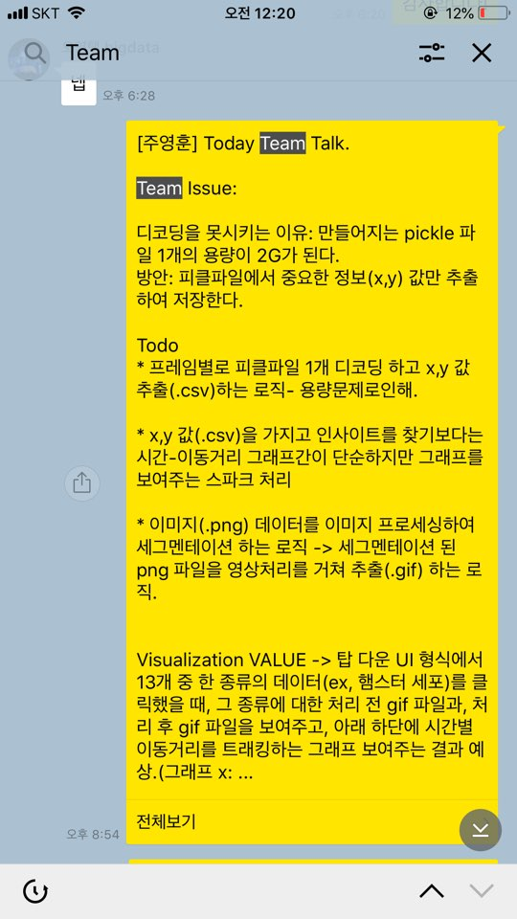
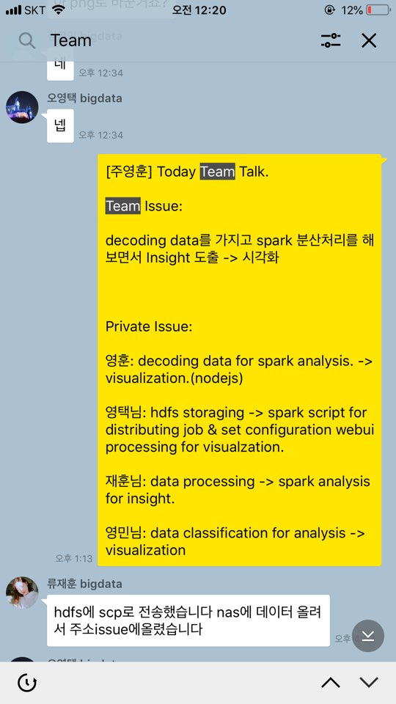
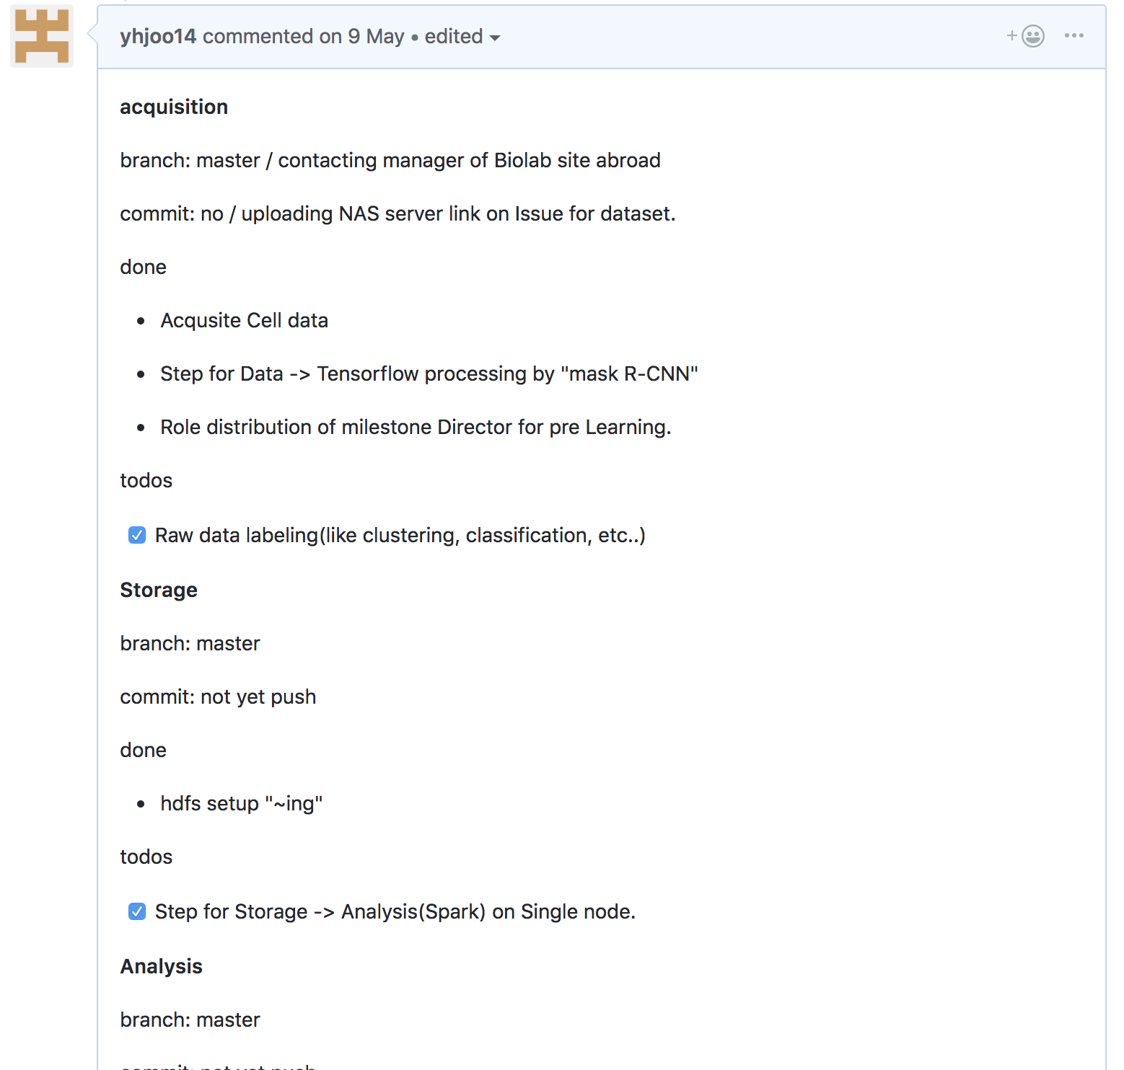
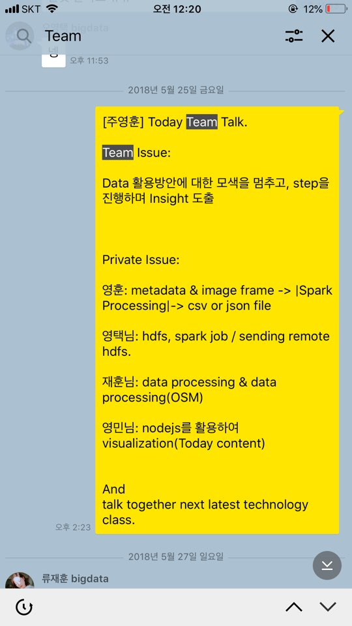
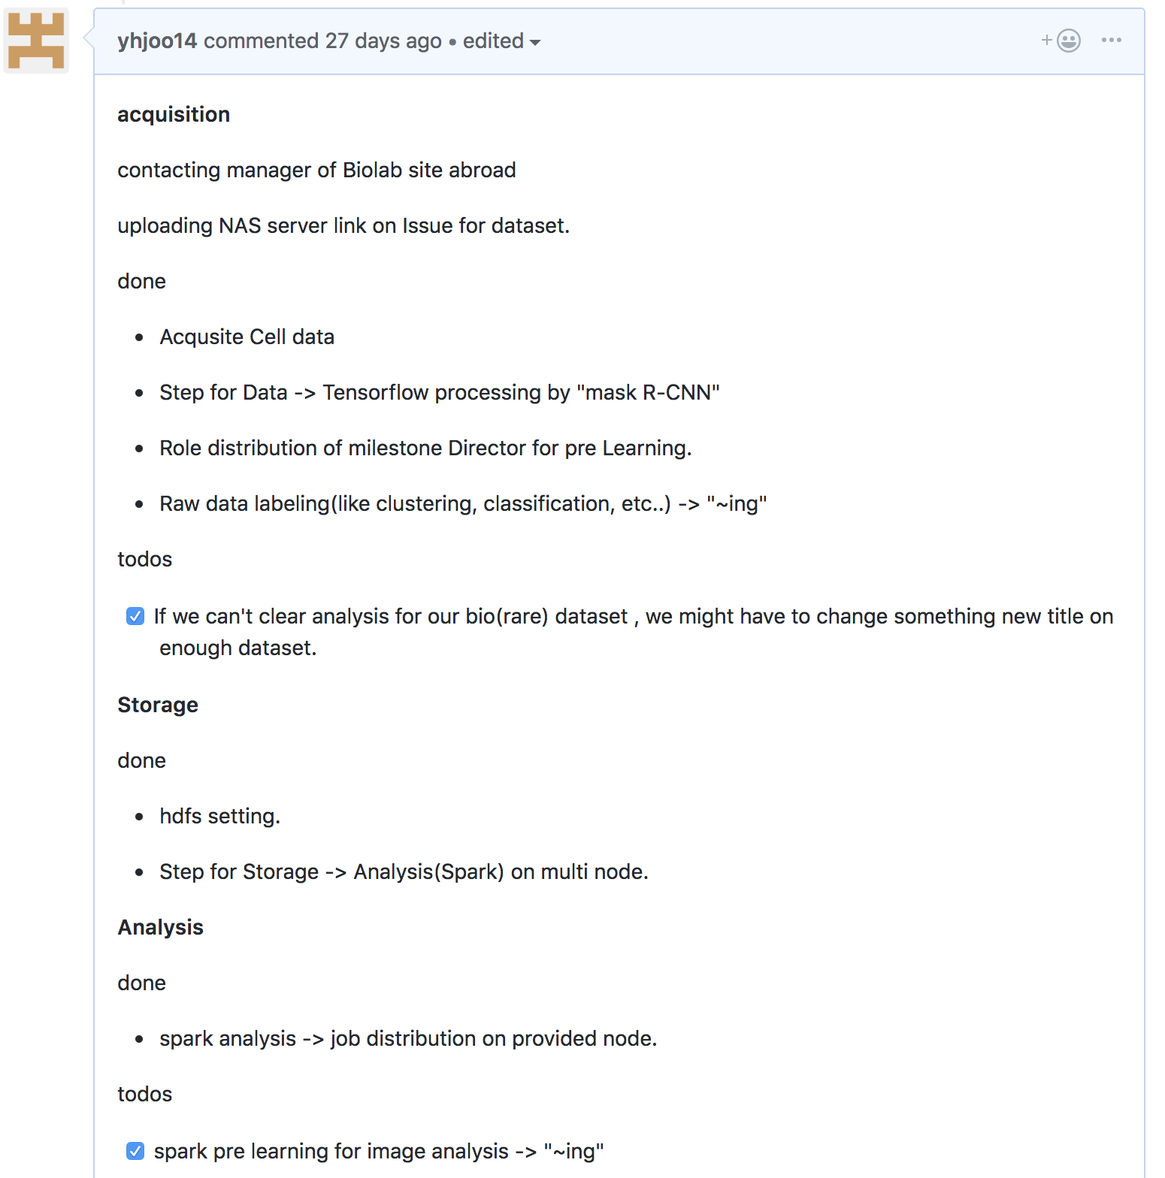
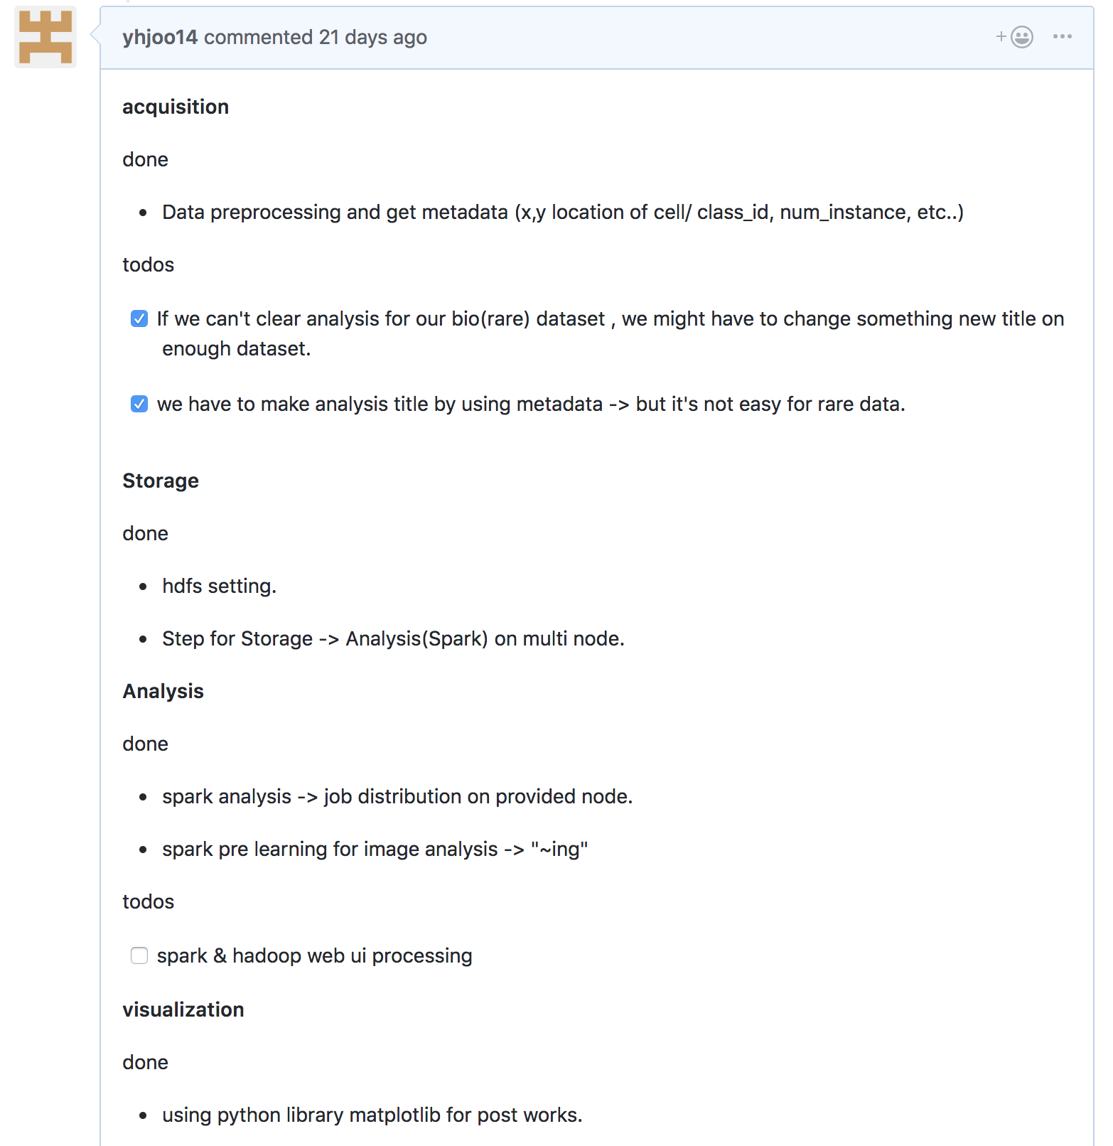
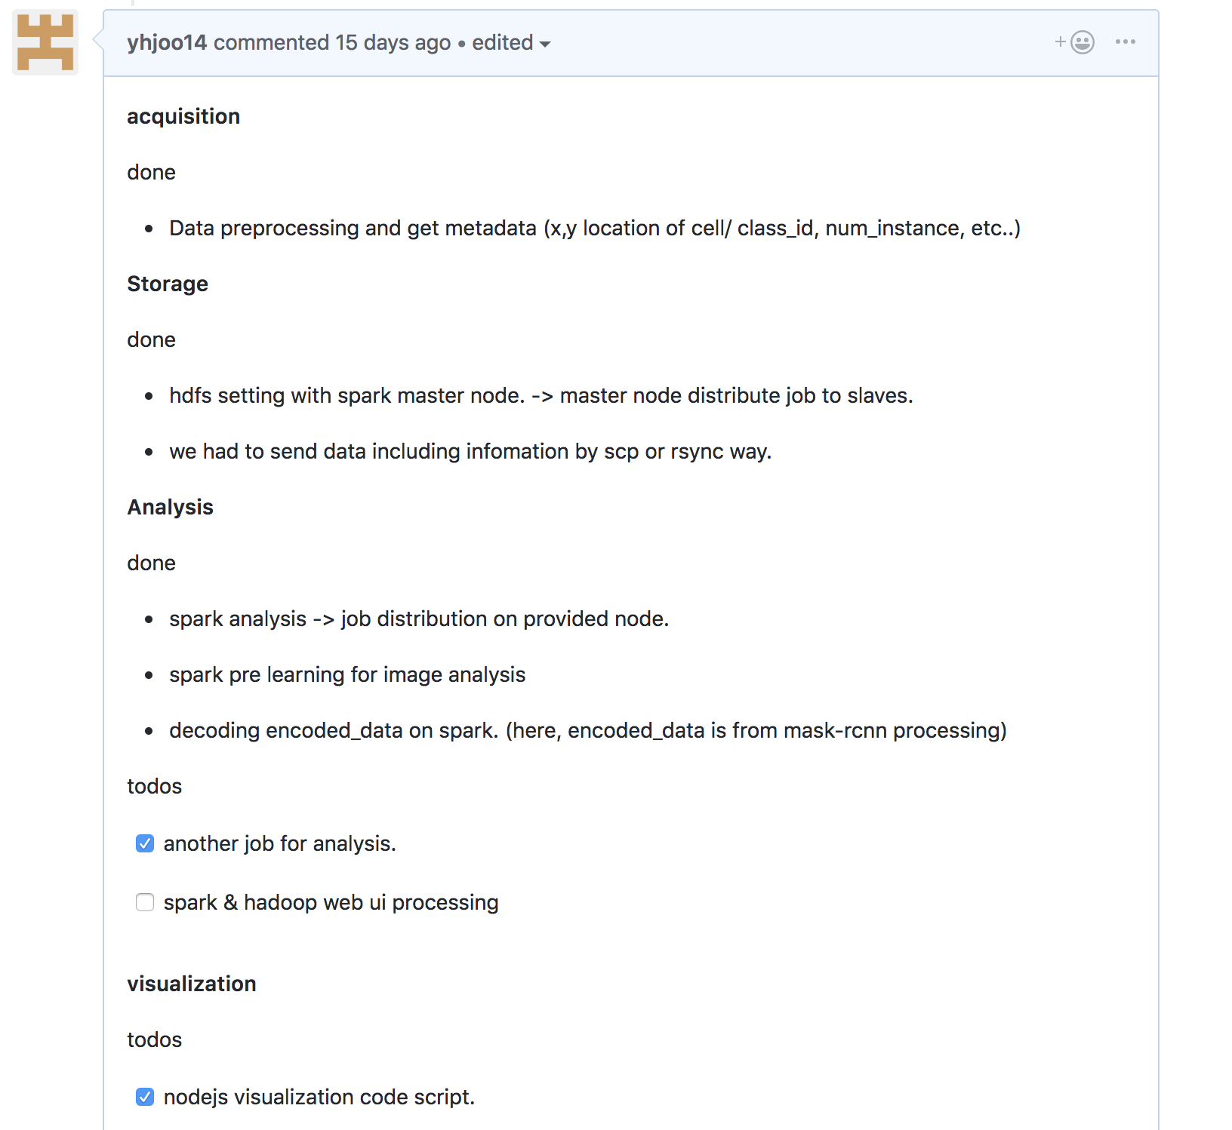
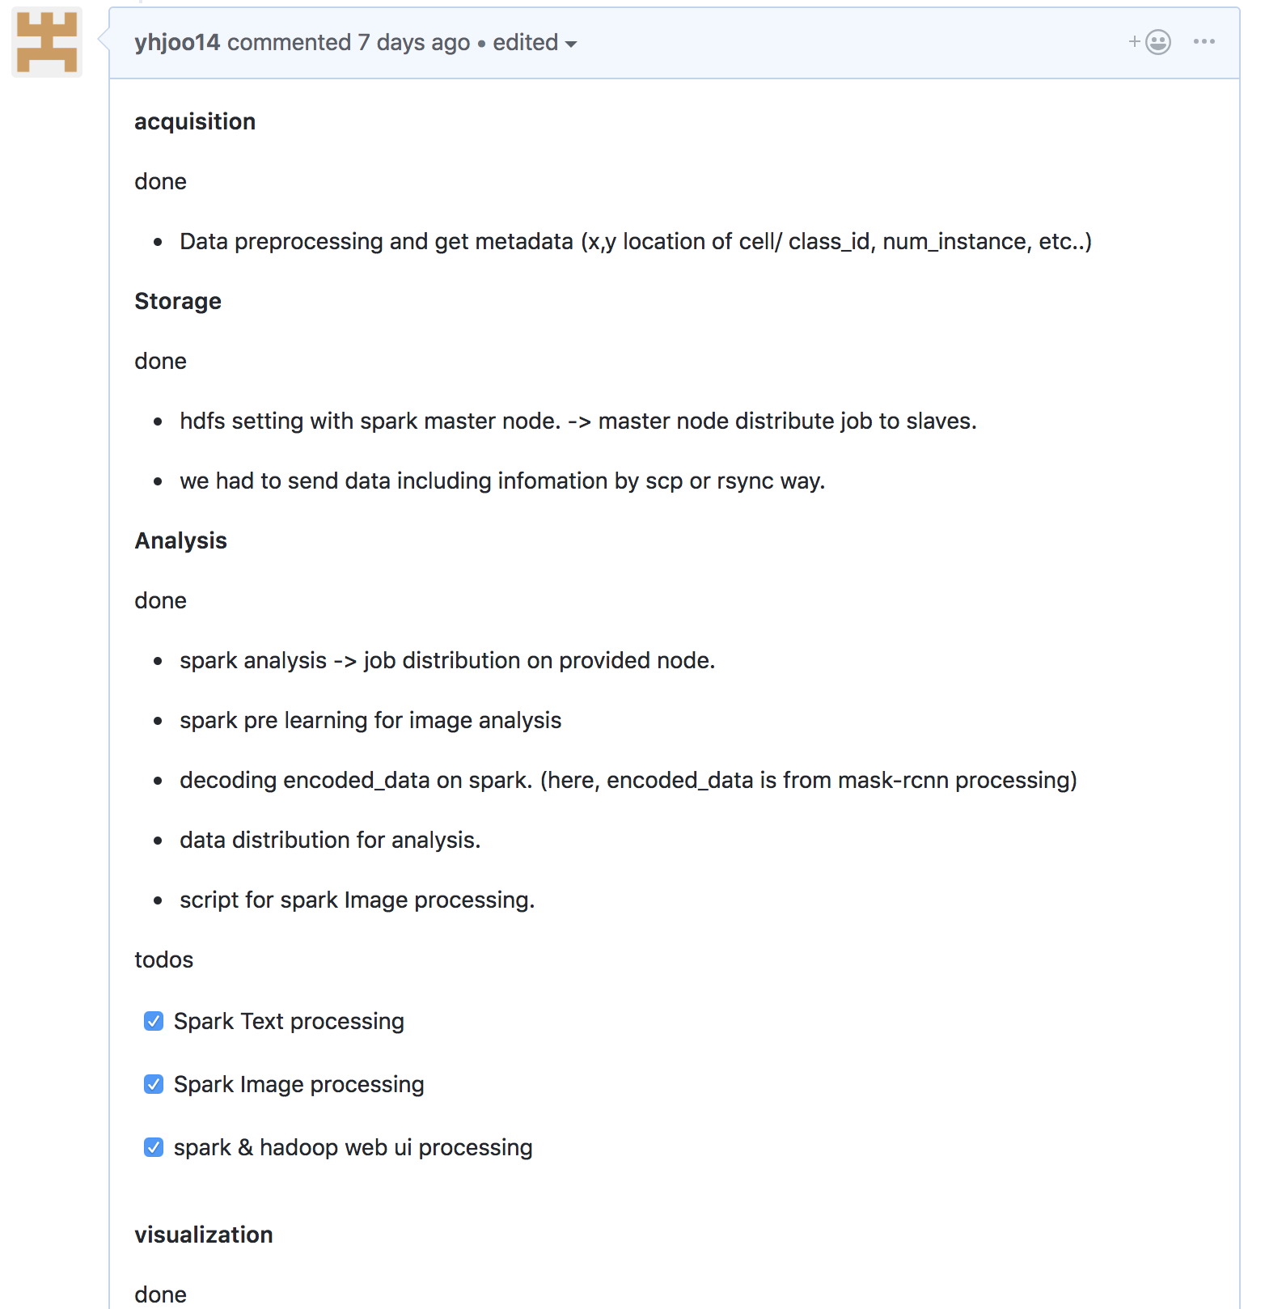
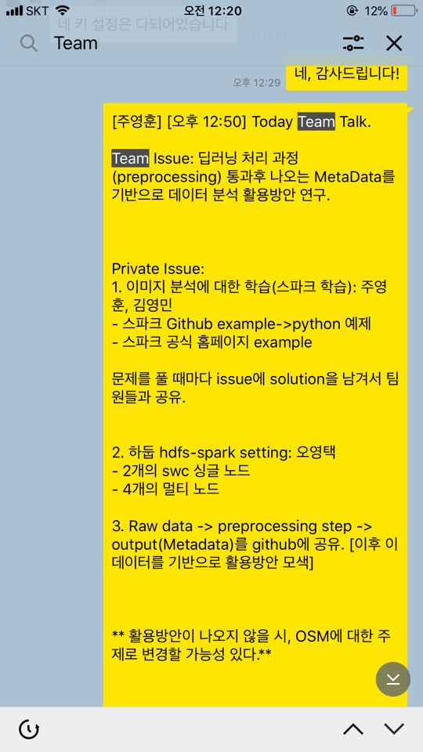
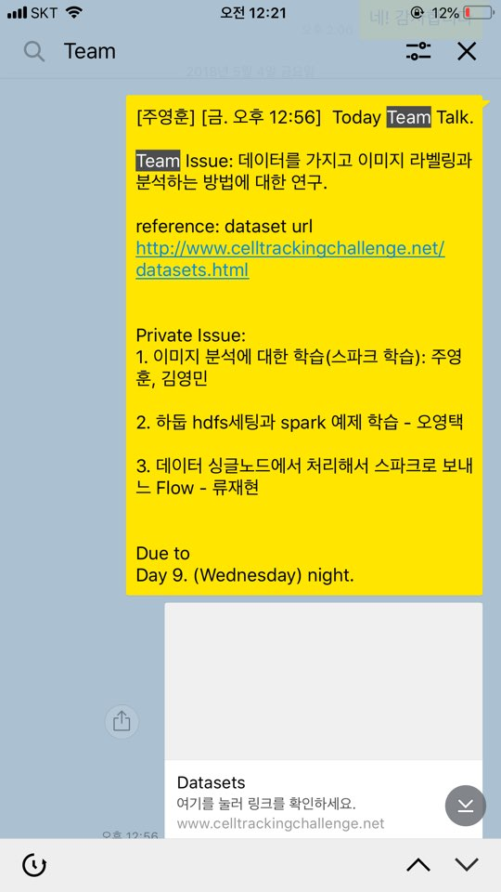
How to share Weekly Progress - 5 Times

Slide 42


Slide 43
Thank you
http://133.186.134.34:8060

